Slide 1

SPM - UX Improvements

Slide 2

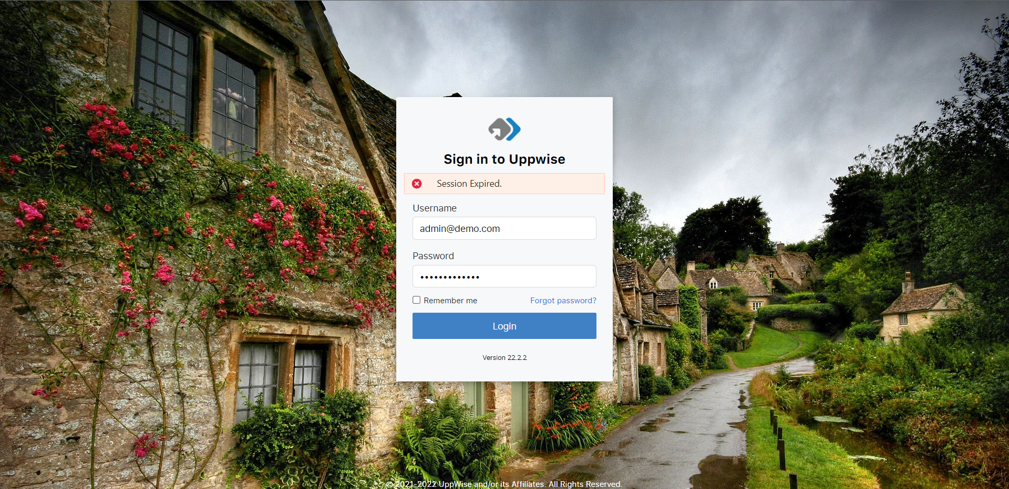
Login Page:
Over the login page – we need to remove the random changing landscape images, we can place a strategy management or the linear background, as we are following the similar pattern from the POX
While opening forgot password the whole page is getting refresh which is not correct, the page loading should only happen in the time of redirections, we need to avoid the same as much we can.
Login page is the first action page for the user, we should add a short information about the product and the benefits.

Slide 3
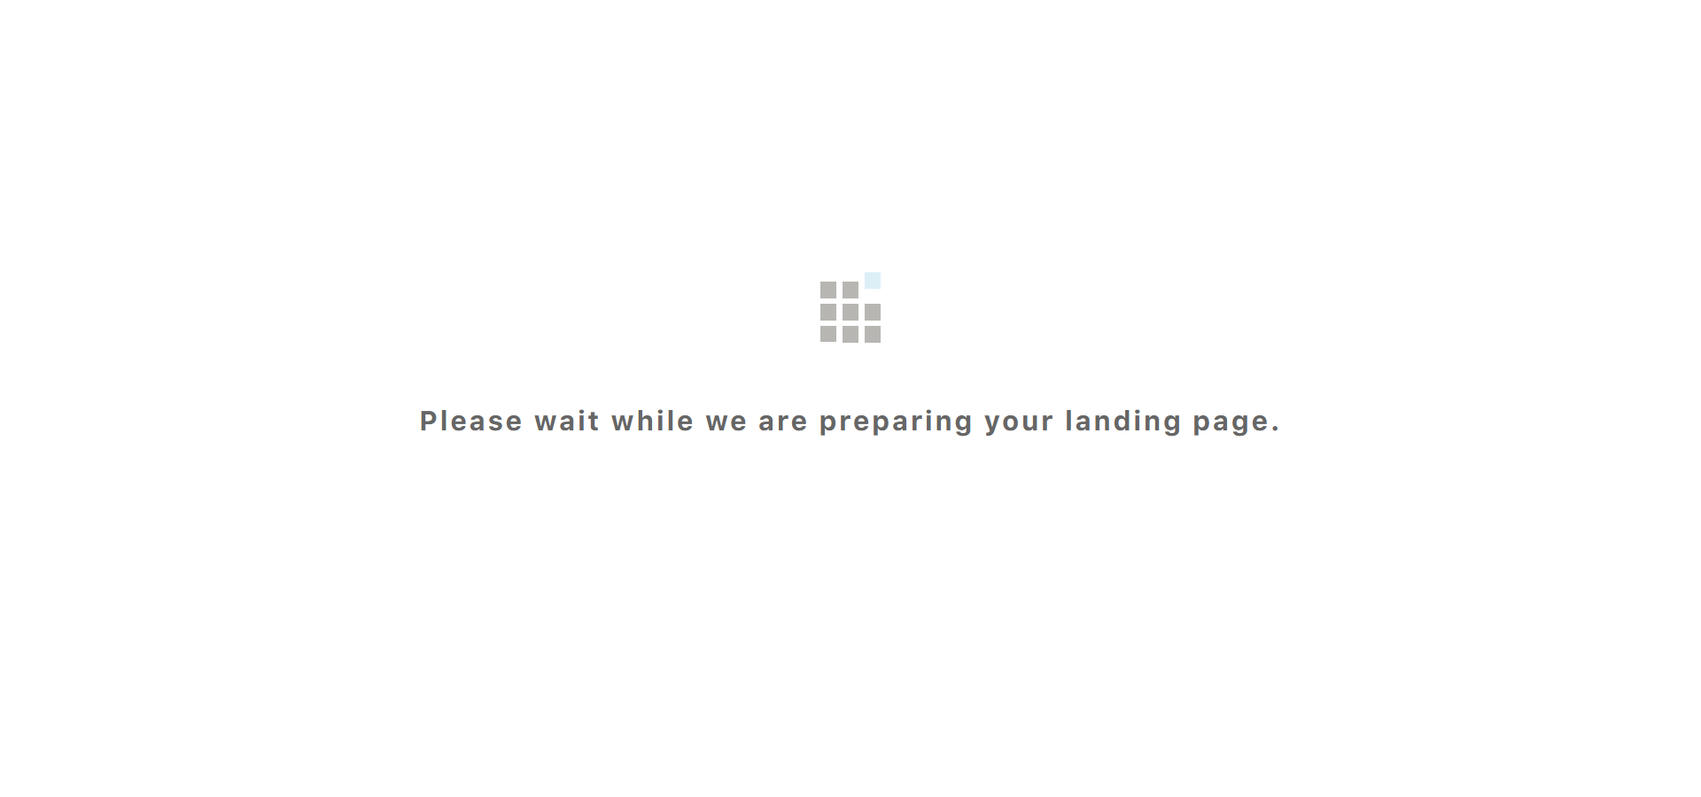
Post Logon Page:
Over the post logon page we need to create and place our custom logo symbol loader, as in terms of branding the logo symbol will be use.
We used the same message which we already used in the POX, with the fresh can introduce a different tag line for the upcoming page

Slide 4
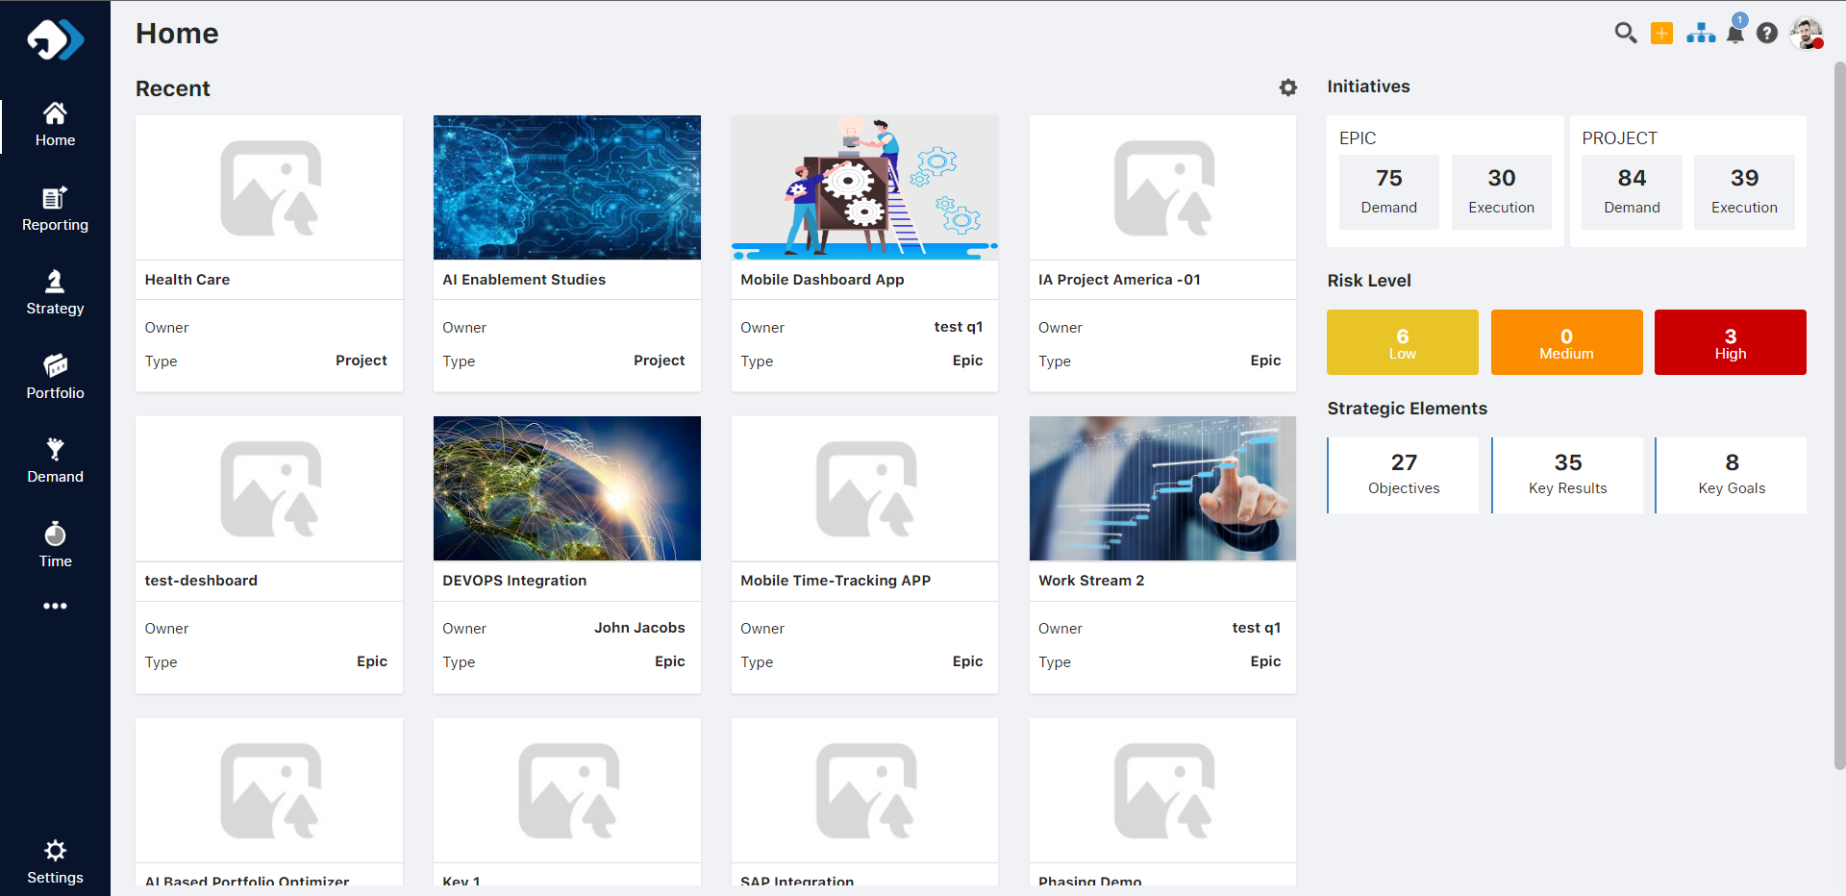
Home Page:
Header title is not required – HOME (We can avoid the repetition of the similar text as user can easily identify through the menu selection)
Reduce the title of the card – As per the screen resolution and the card size we can reduce the font-size of the title
Home is a landing page – We can manage the cards through the carrousel or row slider, to avoid scroll when the Recent card is in max counts

Slide 5
Need to truncate the card values because when the large size of text will come then it will come in two rows so need to avoid the multi-row value (example: if the owner name font-size is big then according the size of card it’s mis-aligned)
We can introduce a intro of the inner modules over the tooltip of menu icons
We can introduce again the info option on menu may be at the bottom and over the click of that option we can present a frame where we can present the intro section or 30 sec clip related to our product. It will work as per the marketing perspective and user engagement
Read Only Fields:
In the application we have form where the read only fields are available but the UI are similar to the editable fields only, in some areas it’s corrected but not in all, need to align.
Example: Detail form page – Non-editable fields are similar to the editable one

Slide 6
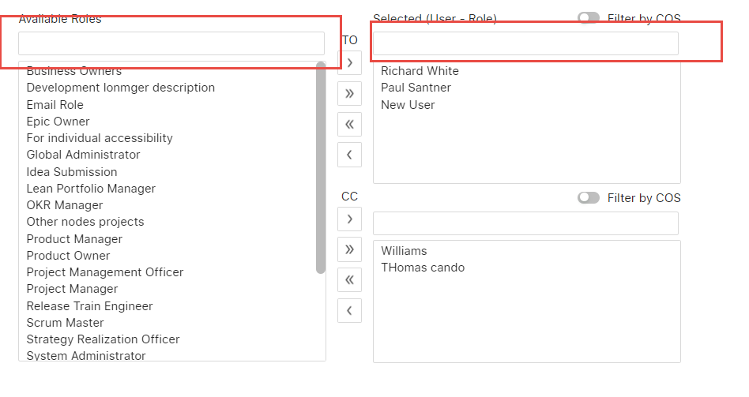
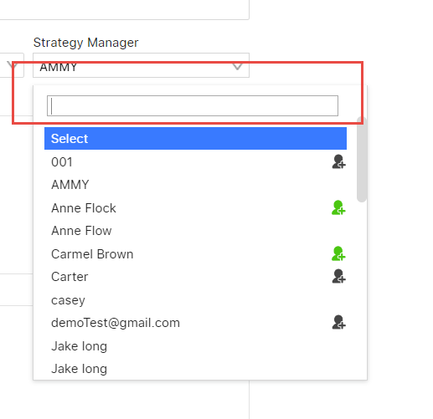
Read Only Fields:
In all over the application the search functionalities are implemented in multiple areas like grid, filter, top header bar, popups, roles or inside the dropdowns. The UI is not as per the standard, in some area’s user can’t able to find out the difference between search and textbox – For the same, we need to align the design with the standard or need to provide the placeholder at-least.

Slide 7
Introduce new help center:
In the application the help container which we are using a bit confusing and there are lot possibilities to enhance the structure and the functionalities in a better way.
First of all if we are creating broad level of details and maintained in the slides format then it’s should be inhouse (in same repos or link), currently it’s redirecting to the other area to check the help information.
Second the categorization of the topic should be clear to customer and the selection or choosing options over the view details should be more convenient. Currently there is a list in one header and no separate categories.
Introduce a video section also it will be easier to understand the solution over the customer query
We can open an all together a new page for the help center, so that we can show the information in a detail way
Over the help admin there is an option to manage the edit of the categories and have option to add custom URL for the redirection, I think the URL part is not an good idea. Suppose if someone place any false URL then it will directly visible over the help and customer will be misguided like currently over the welcome message there is a link of logon.
Few designs type:
https://www.searchenginejournal.com/best-faq-page-examples

